Slide 1


COLLEGE OF MEDICINE RESIDENTS BENEFITS & RETIREMENT ORIENTATION

Slide 2

State Benefit Programs
The State of Florida offers the following pre-tax insurance options:
Health
Dental
Vision
Flexible Spending Accounts
(Medical Reimbursement Account, Dependent Care Reimbursement Account, etc.)
Other Supplemental Insurances
(Accident, Cancer, Disability, Intensive Care, Hospitalization)
Insurance elections must be made through People First
Notes:
Resorted and added Disability.

Slide 3

Who is People First?
Plan administrator for State of Florida insurance, including state universities like FAU
Responsible for the following:
Plan Enrollments
Dependent Eligibility
Qualifying Status Changes
Open Enrollment
COBRA

Slide 4

New Employee Benefits Guide
Visit:
http://mybenefits.myflorida.com/
Click on Plan Year Benefits Guide
Notes:
Removed, “Go to: Health>Benefits Guider”

Slide 5

How to Enroll
Online
https://peoplefirst.myflorida.com
User ID and Password Required
People First Service Center
Call 1-866-663-4735
User ID Required
Available Monday – Friday 8am-6pm

Slide 6
To Receive People First User ID
Employee information is entered into Workday (onboarding completed in full)
Daily electronic file is submitted to People First on hire date.
You will receive your People First ID from the Benefits office via e-mail.
People First also mails informational packet (including User ID) to employee’s home address, as listed in Workday.

Slide 7

People First default password: Pf + Birthdate = PfMMDDYY

Slide 8
Insurance Effective Dates
Employees have 60 days from hire date to enroll in insurance. The earliest effective date for health insurance is the:
1st day of the month following hire.
Example: If you are hired on May 9, 2023, the earliest your health insurance coverage can be active is June 1, 2023*.
*You must complete your enrollment with People First before 5pm on May 31, 2023.
Supplemental Insurance Plan effective dates are normally the 1st day of the
month after deductions have been taken.

Slide 9
Changing Insurance
Employees have two (2) ways of changing insurance elections after the 60 day new hire period:
Qualifying status change
Examples: Marriage, divorce, birth/adoption of child, spouse insurance termination, etc.
Open Enrollment
Held annually each Fall (begins mid/late October)
Coverage changes effective January 1 of the following year

Slide 10

Eligible Dependents
Spouse (Legally Married)
Children (up to age 26)
May be eligible until age 30 if they meet certain criteria:
Unmarried, no dependents of their own, dependent on you for financial support, live in Florida or attend school in another state, and have no other health insurance
Children with disabilities may be covered after age limit if they meet certain criteria
Dependent eligibility verification documentation is required by People First!

Slide 11
Health Insurance
Insurance cards are mailed AFTER the effective date. You can also login to your plan provider website, after the effective
date, to print temporary id cards.
Premiums are paid one month in advance and will be automatically deducted from
FAU biweekly paychecks.

Slide 12
Types of Health Insurance:
PPO – Florida Blue (Blue Cross Blue Shield)
Includes in-network and out of network benefits and deductibles.
HMO –Providers differ, depending on county of residence.
In-network coverage only, no deductibles or out of network coverage.
COUNTY | PLAN PROVIDER
Palm Beach / Martin | United Healthcare HMO
Broward / Miami-Dade / St. Lucie | Aetna HMO
Indian River | Aetna HMO
Plan Options:
Standard
Health Investor Health Plan
(HIHP/high deductible)
*United Healthcare MA-PD PPO – Available to State of Florida retirees only.

Slide 13
Health Insurance: HIHP Option
Health Investor plan offers choice of PPO or HMO
Note – same providers as standard plan options
Employee assumes greater responsibility with healthcare
Lower Premiums
High Deductibles - Including deductibles for HMO plans
Participation in Health Savings Account (HSA) to offset out-of-pocket expenses

Slide 14
Health Insurance Standard Options
Plan Type | Coverage Level | Monthly Premium
PPO or HMO – Standard | Individual = Employee ONLY | $50.00 per month
PPO or HMO – Standard | Family = Employee + eligible dependents | $180.00 per month
PPO or HMO – Standard - Spouse Program | Family = Employee + eligible dependents | $30.00 per month = $15.00 per month/spouse
Premiums listed are for full time employees
**FAU contributes over $750.00 for individual coverage, and over $1,650.00 for family or spouse coverage monthly.

Slide 15
Health Insurance HIHP Options** (high deductible plan)
Plan Type | Coverage Level | Monthly Premium
PPO or HMO – HIHP | Individual = Employee ONLY | $15.00 per month
PPO or HMO – HIHP | Family = Employee + eligible dependents | $64.30 per month
PPO or HMO – HIHP - Spouse Program | Family = Employee + eligible dependents | $30.00 per month = $15.00 per month/per spouse
**Includes HSA with FAU contribution
$41.66/month individual up to $500/annually
$83.33/month family, up to $1,000/annually
Premiums listed are for full time employees

Slide 16
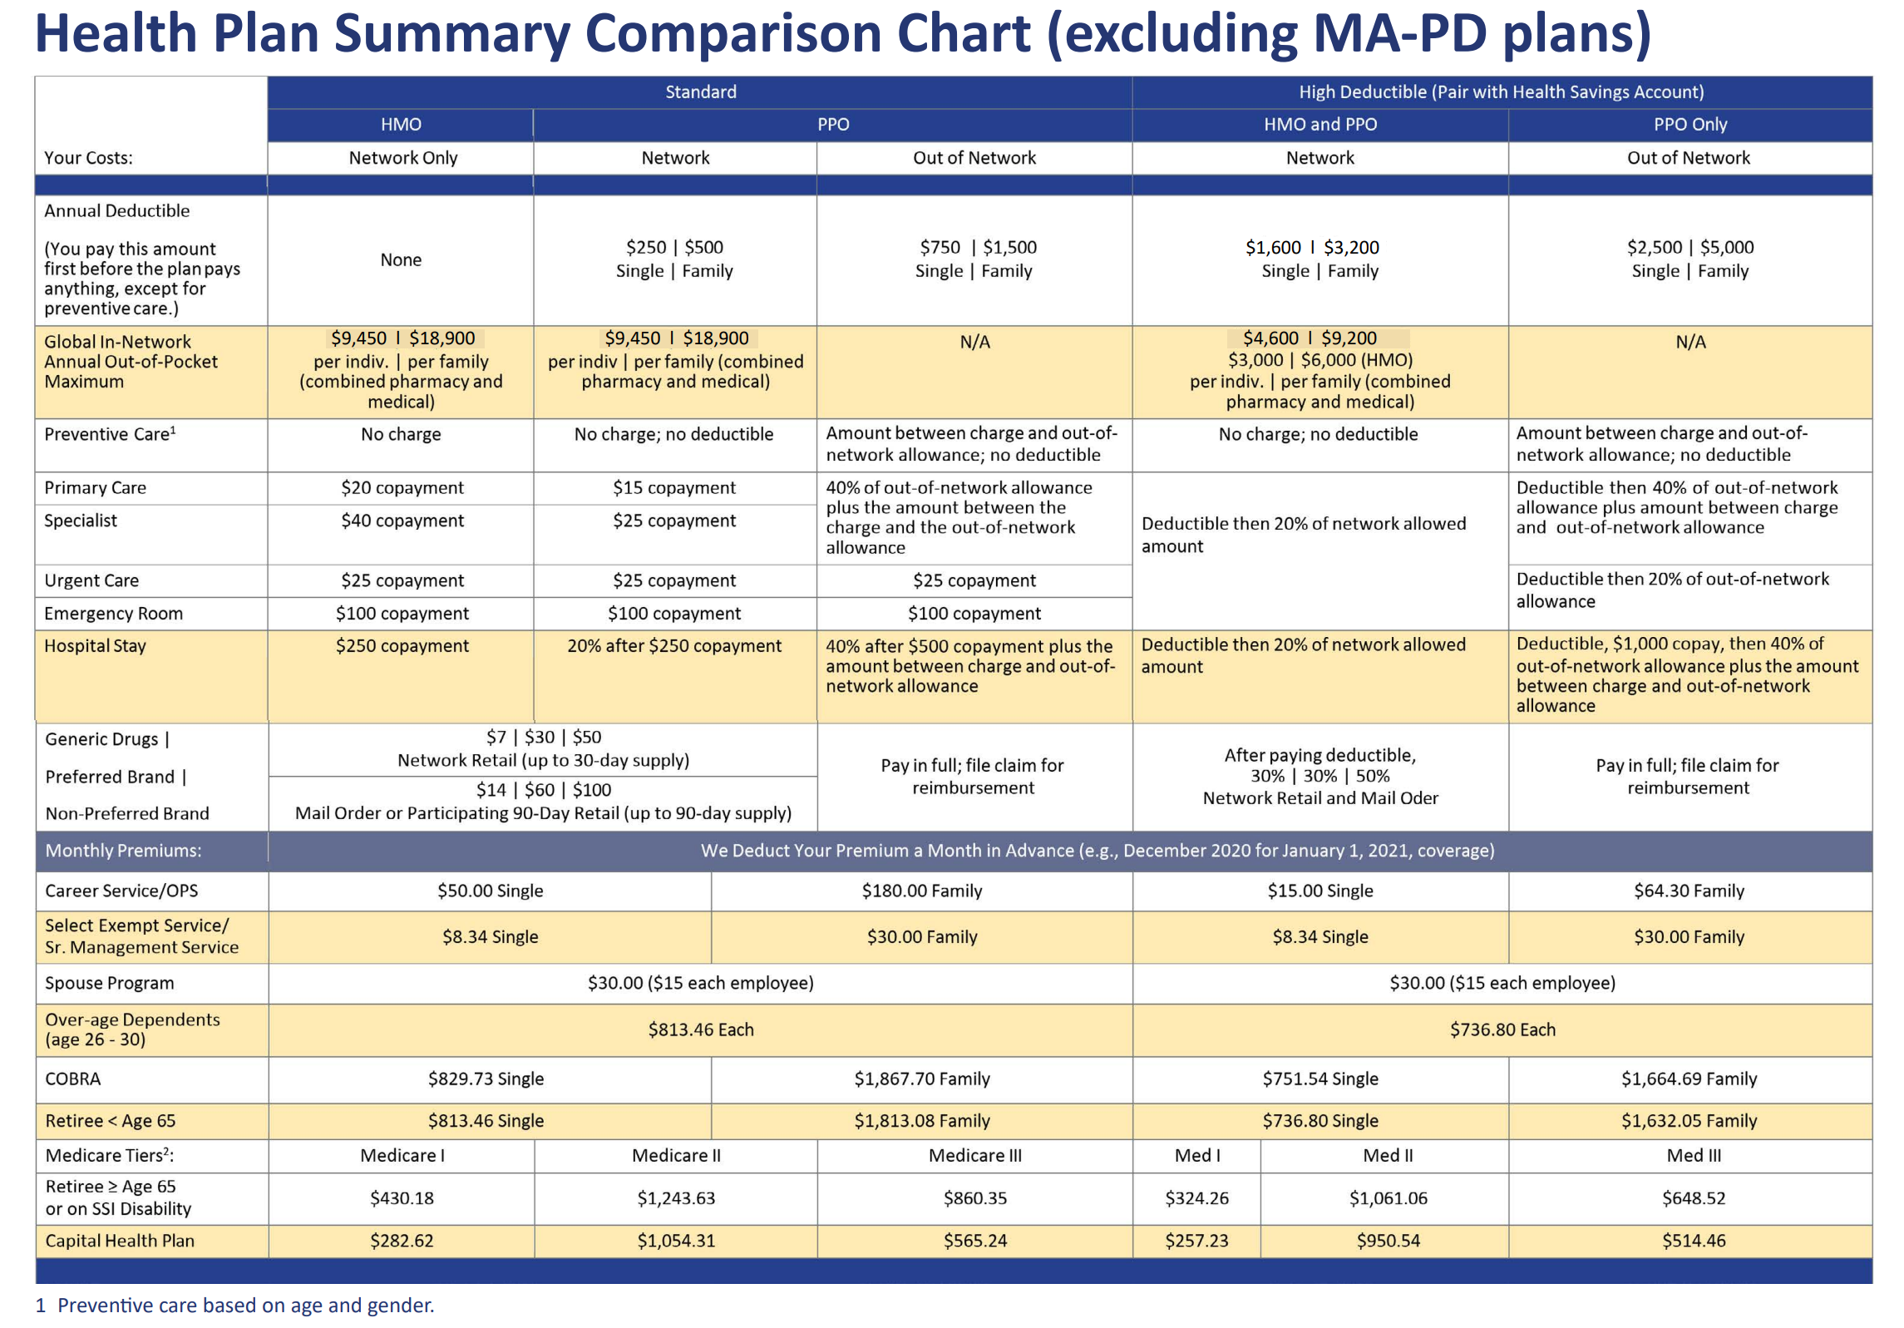
Health Plan Summary Comparison Chart (excluding MA-PD plans)

Slide 17

DEDUCTIBLES: Standard vs. HIHP
Health Plan | Coverage Level | In-Network Deductible | Out-of-Network Deductible
HMO – Standard | Individual/Family | None | None / No out of Network Coverage
PPO – Standard | Individual/Family | $250 / $500 | $750 / $1,500
PPO/HMO –HIHP | Individual | $1,600 | $2,500
PPO/HMO –HIHP | Family | $3,200 | $5,000
Under “HIHP” plans, you are responsible for 100% of medical bills and prescription costs until annual deductible has been met.

Slide 18

Standard Plan or High Deductible Plan?

Slide 19

Prescription Drugs – OptumRx
OptumRx www.OptumRx.com/sofdms | Standard HMO & Standard PPO |  | HIHP HMO & PPO- subject to deductibles
 | Retail (30 Day Supply) | Mail Order &/or Retail (90 Day Supply) | Retail (30 Day); Mail Order &/or Retail (90 Day Supply)
Generic | $7.00 | $14.00 | 30%
Preferred Brand-Name | $30.00 | $60.00 | 30%
Non-Preferred Brand-Name | $50.00 | $100.00 | 50%

Slide 20
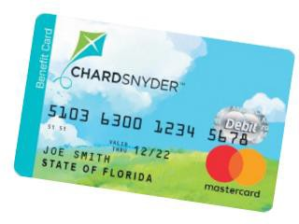
Flexible Spending Accounts
It’s easy to manage your account!
Chard Snyder is the administrator of three types of Flexible Spending Accounts (FSA) that give you a tax break on eligible out-of-pocket expenses.
Use the prepaid Chard Snyder Benefit Card at the time of service as a convenient payment option wherever most credit cards are accepted.
Employees must contribute a minimum of $60 per year to initiate an FSA.
Medical Reimbursement Account / Health Savings Account | Dependent Care Reimbursement Account
Deductibles / Co-payments / Co-Insurance / IVF Insulin supplies / Contact Lenses / Vision Expenses | Day care / In-home care / Nursery School Pre-school and afterschool care/ Summer Camp Elder Care services
****See IRS Pub 502 for all qualified expenses! | Use it or Lose it!

Slide 21
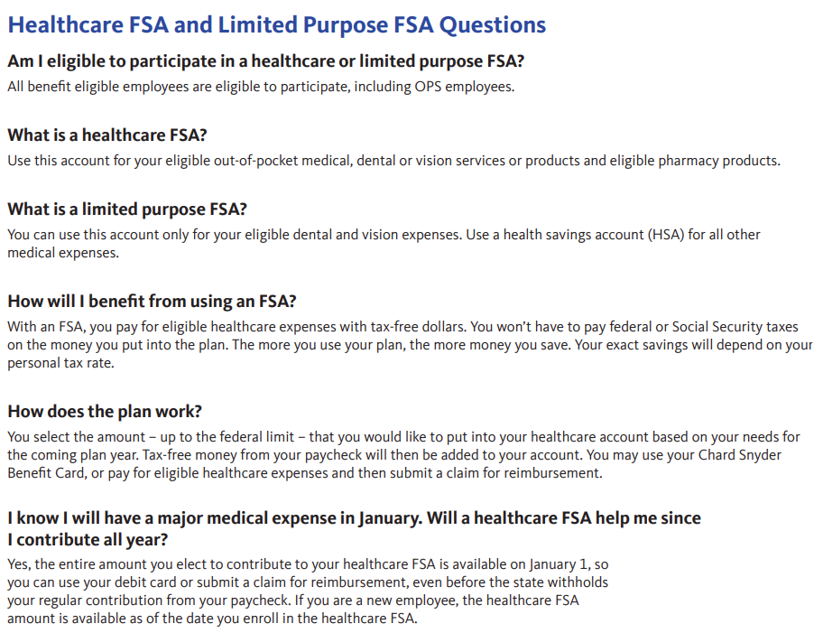
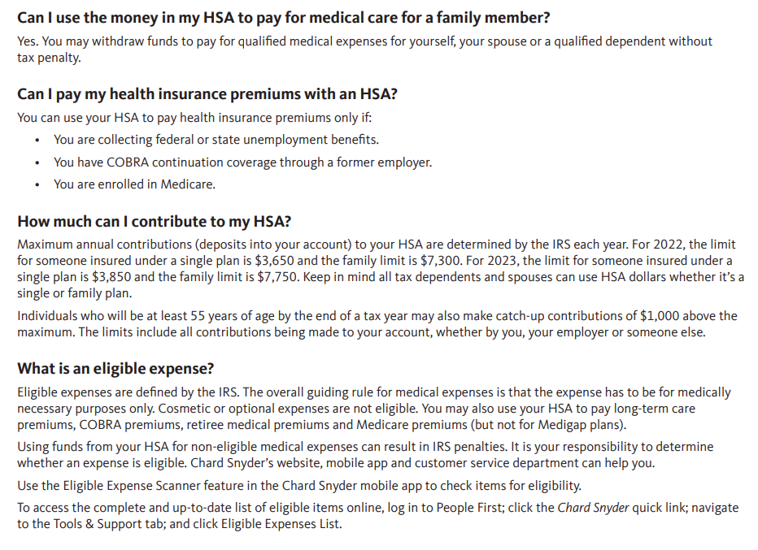
FSA and HSA FAQs
FSA FAQs
HSA FAQs

Slide 22

Healthcare Bluebook
Shared Savings: Healthcare Bluebook
Offers an online transparency website for you to “shop” for healthcare services, facilities,
and providers
You can earn rewards for some of the services that you or your dependents “shop” for.
The rewards you generate can be deposited in your:
Health reimbursement account (HRA)
Post-deductible HRA (for enrollees in a high deductible health plan)
Health savings account (for eligible enrollees in a high deductible health plan)
Flexible spending account (FSA) (for enrollees in a standard health plan)
Limited purpose FSA (for enrollees in a high deductible health plan)
800-513-6118

Slide 23

SurgeryPlus
Shared Savings:
SurgeryPlus
SurgeryPlus is a voluntary benefit that provides pre-planned, non-emergency surgical services.
By receiving services through SurgeryPlus, you and your dependents can earn financial rewards
Coordinates services:
For example, rather than paying separately for the surgeon, facility, anesthesiologist,
and radiologist, SurgeryPlus negotiates one “bundled” rate.
844-752-6170

Slide 24
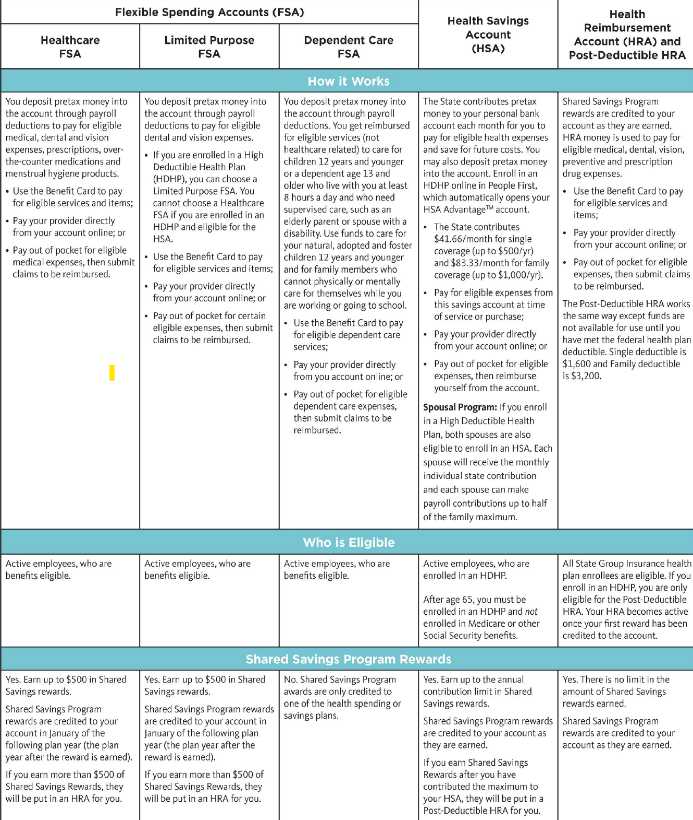
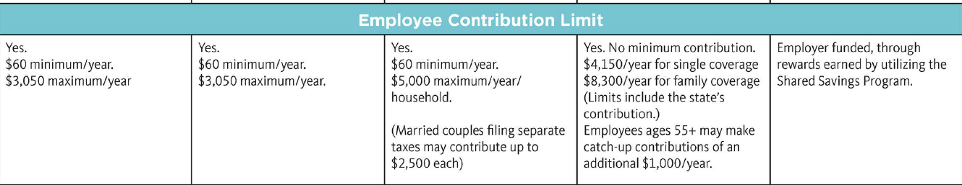
2024
Flexible Spending Accounts
FSA- Automatically carries forward to next plan year
HSA-$500- Single
$1,000- Family

Slide 25

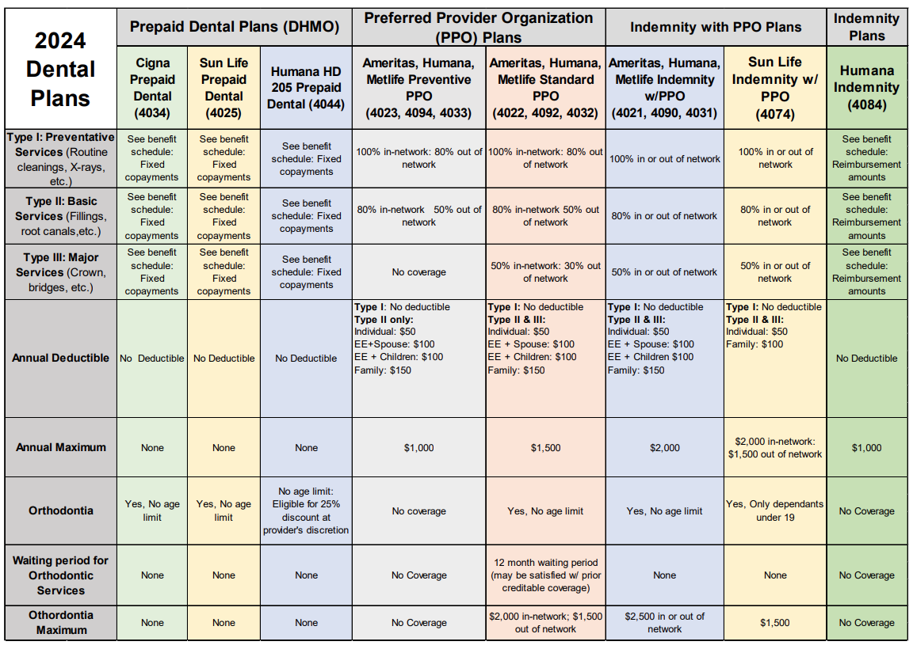
2024
Dental Insurance

Slide 26
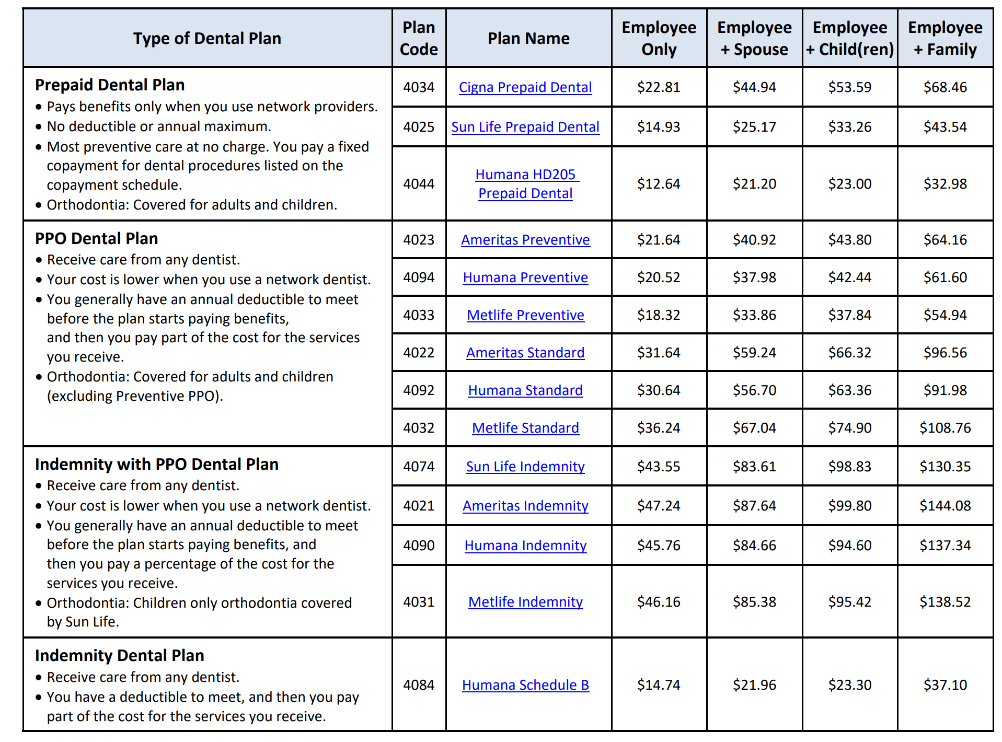
2024 Dental Insurance

Slide 27
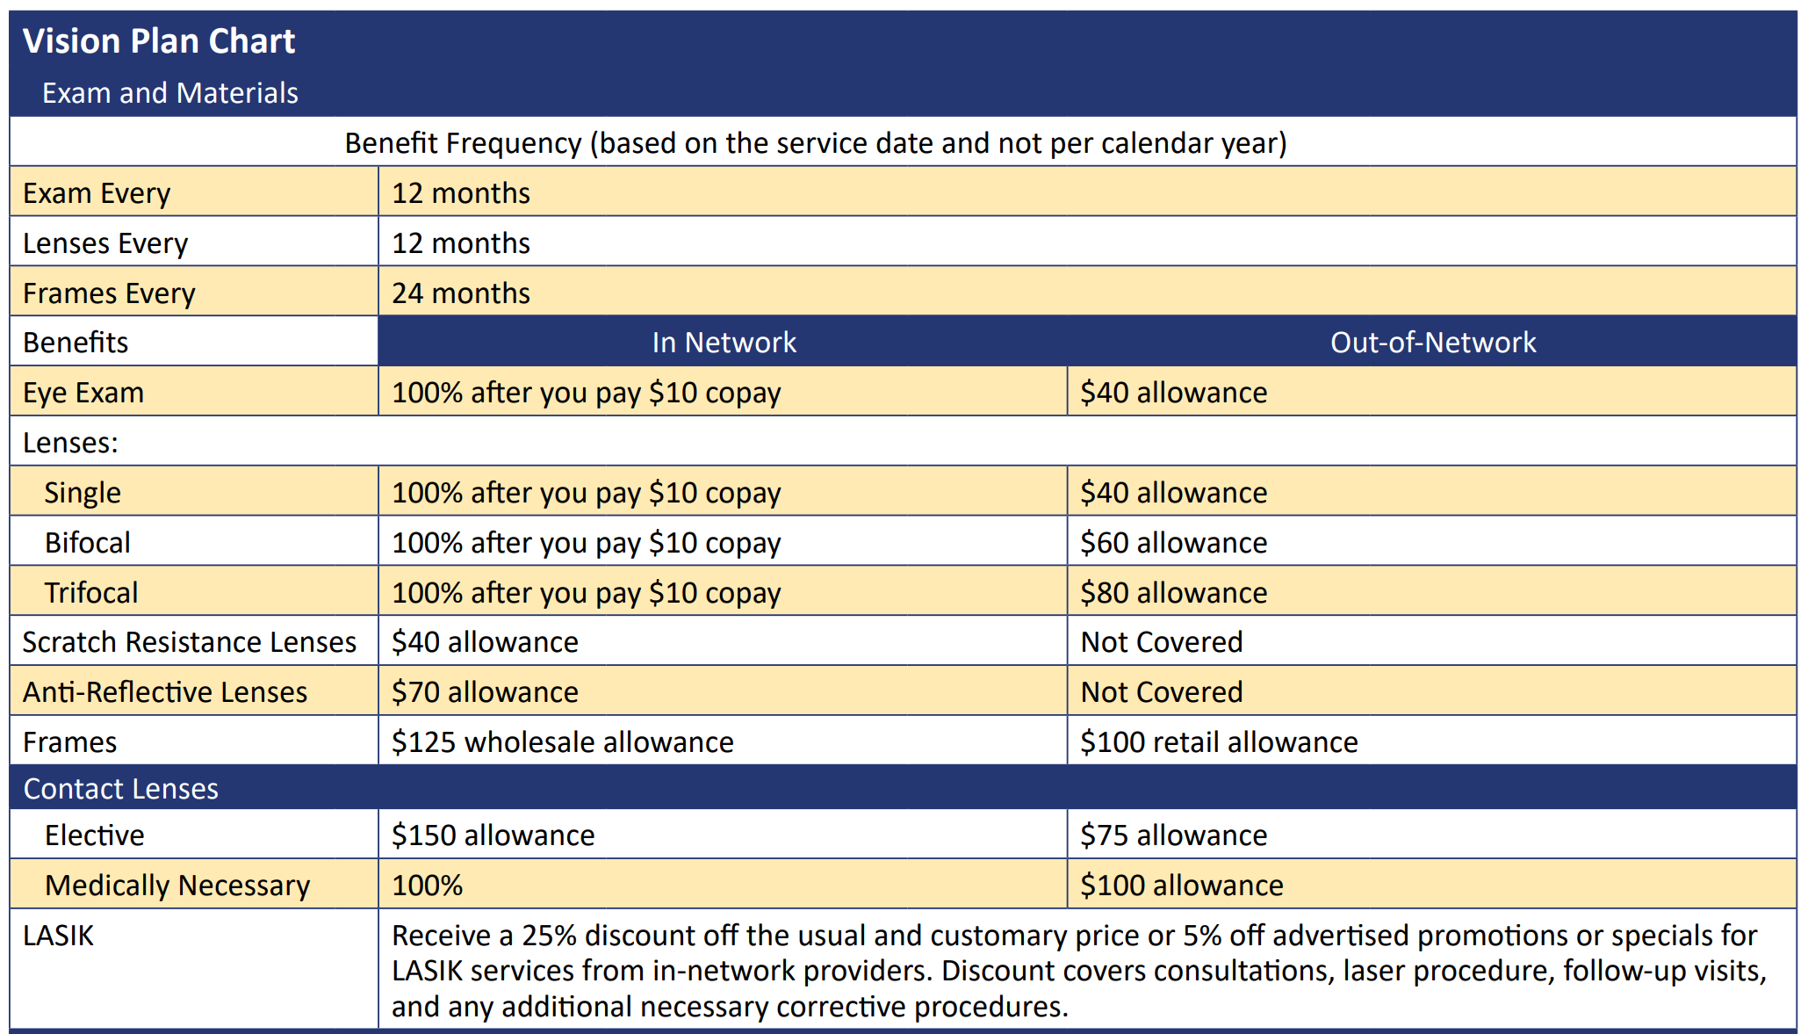


2024
Vision Insurance
Coverage Level | Monthly Premium
Employee Only | $5.92
Employee + Spouse | $11.68
Employee + Children | $11.56
Family | $18.16

Slide 28

Supplemental Insurance Plans through People First
Hospitalization
Cigna & New Era
Cancer/Intensive Care
AFLAC & Colonial
Accident/Disability
Colonial
Required to meet with company representative to complete medical underwriting
Plans can either work in conjunction with or independently from health insurance
Coverage effective date determined by People First

Slide 29




Other Employee Benefits
Gabor Agency
Disability Plan – paid by COM
Preferred Legal Plan
Unlimited Legal Advice via phone | Can cancel at any time | $4.98/Bi-weekly Premium
Credit Unions
iTHINK Southeast Employees Credit Union (Formerly IBM) | Bright Star Credit Union | Gold Coast Federal Credit Union
Employee Discounts
Cell Phone Service – Sprint/Verizon/AT&T | Broward Center for the Performing Arts | Rapids Water Park Tickets at Work - Orlando Attractions
Apartments

Slide 30
Aetna Resources For Living
Employee Assistance Program
Investing in your career with completely confidential counseling
3 free session per issue with a private licensed therapist for guidance on:
Financial Issues | Legal Issues | Relationships
Stress or Anxiety | Grief Issues | Depression
Child & Elder Care | Alcohol Abuse | Drug Abuse
Life Improvement | Family Challenges
Call: 800-865-3200
www.mylifevalues.com
Login ID: Florida Atlantic University Password: EAP

Slide 31
Voluntary Retirement Options
Employees who wish to make Voluntary contributions toward retirement may do so through the following options:
403(b)
Roth 403(b)
457 State Deferred Compensation
FAU does NOT match voluntary employee contributions
Voluntary enrollments and/or changes can be made at any time using Salary Reduction Agreement:
SALARY REDUCTION AGREEMENT
Multiple vendors/providers are available – please contact one to open your FAU
affiliated account

Slide 32
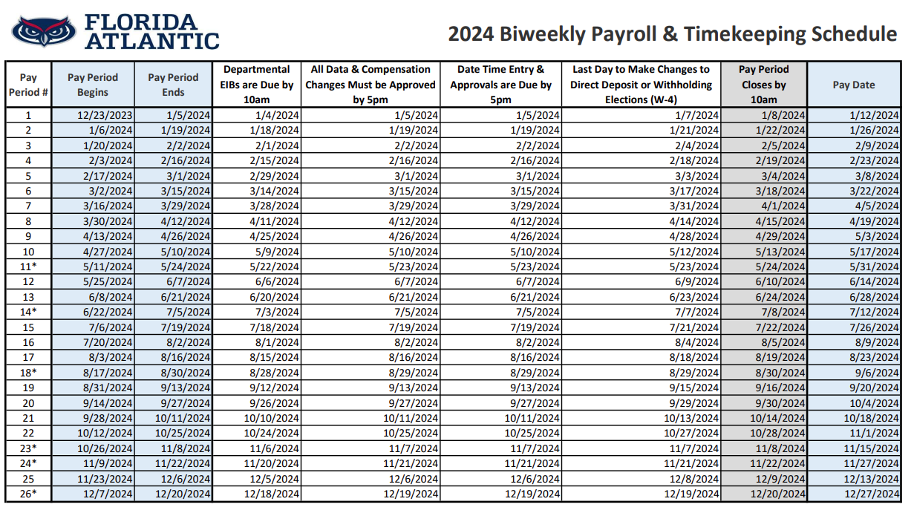
2024 Biweekly Payroll & Timekeeping Schedule
Payroll Schedule

Slide 33
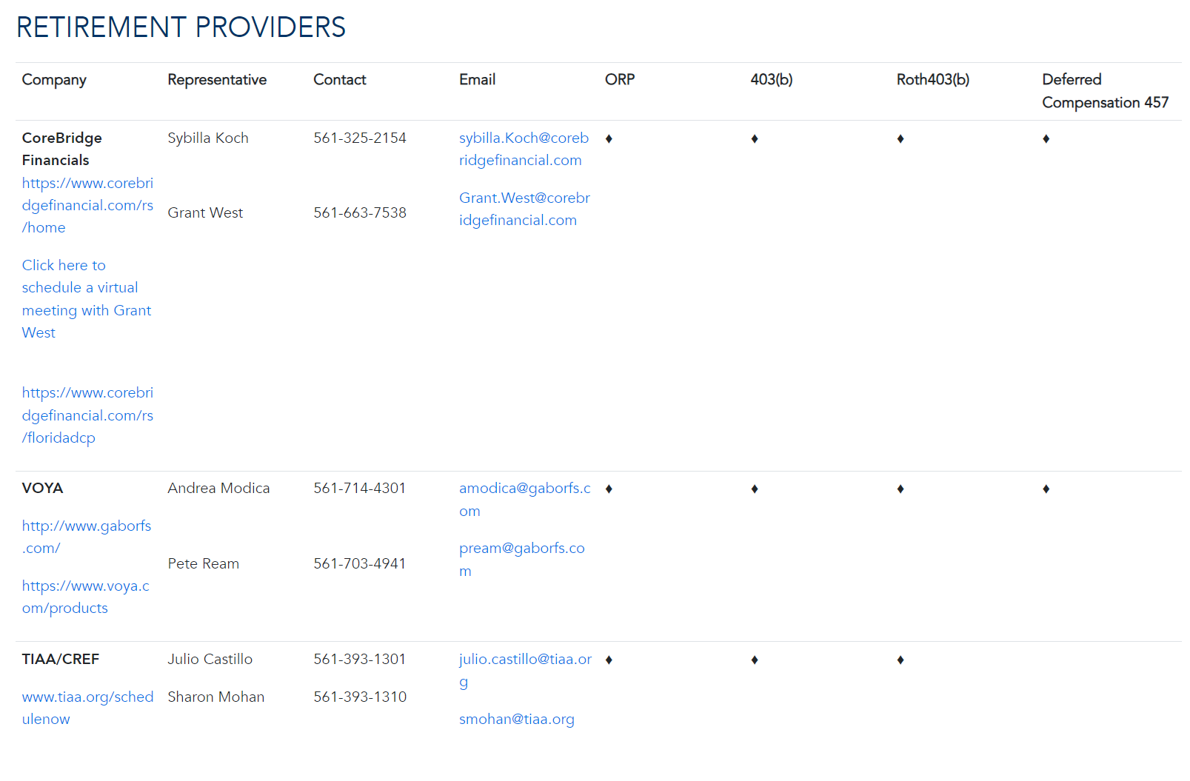
RETIREMENT
PROVIDERS

Slide 34
RETIREMENT
PROVIDERS (cont’d)

Slide 35

How to Enroll – Voluntary Retirement
403(b) or ROTH 403(b)
Open voluntary retirement account with one of the six (6) voluntary
403(b) companies:
VALIC
VOYA
TIAA-CREF
T Rowe Price
Fidelity
2024 IRS Maximum:
$23,000:
Employees under
age 50
$30,500:
Employees age, 50 and older
457 Deferred Compensation
Contact the State Office of Deferred Compensation
Email benefits@fau.edu for contact information

Slide 36
IMPORTANT
Insurance Enrollment Deadline:
60 Days from Hire Date

Slide 37
Leave of Absence
Your eligibility to continue benefits during a leave of absence depends on the reason for your leave. Each benefit plan offers different options. Please contact the Benefits Team at benefits@fau.edu to discuss your specific situation and available coverage options.

Slide 38
Human Resources Benefits & Retirement 777 Glades Rd
Building IS-4, Second Floor
Benefits & Retirement Staff :
Insurance: 561.297.3058
Retirement: 561.297.3073
Secure Fax: 561.297.4220
Email: benefits@fau.edu
Web: www.fau.edu/hr/benefits

