Slide 1


The Office of Undergraduate Research and Inquiry (OURI)
www.fau.edu/ouri
Undergraduate Research and Inquiry
General Classroom South, GS Suite 209
www.fau.edu/ouri
ouri@fau.edu
561-297-OURI (6874)

Slide 2
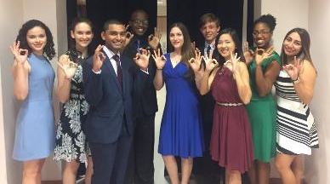
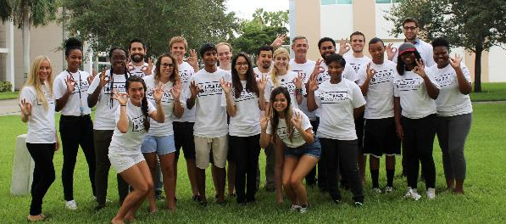
Office of Undergraduate Research and Inquiry
Centralized support office for FAU faculty, staff and students who are engaged in undergraduate research, scholarship, and creative activities.

Slide 3
Why get involved?
Students who participate in Undergraduate Research...
engage their curiosity and intellect
acquire invaluable academic and professional skills
have increased academic aspirations and are more likely to finish their undergraduate degrees
learn valuable skills that will assist in the workforce
make connections with faculty members and faculty mentors, which also leads to higher graduation rates
are more likely to continue onto graduate school

Slide 4
We Can Help You…
Get Funded:
  Undergraduate Research Grants
  Summer Research Fellowships
Get Recognized:
  Undergraduate Research Symposium
  Regional or national conference travel
  Undergraduate Researcher of the Year Award
Get Published
  FAU Undergraduate Research Journal
Get Involved:
  Join the Council for Scholarship and Inquiry (CSI) – student club
Get Prepared:
  Peer Mentoring Program
  Research enriched courses
  Directed independent research
..and much more!
Website: www.fau.edu/ouri

Slide 5

Get started!
Workshops:
  “How to Get Started in Research”
    When? Wednesday August 30th at 10.00 am
    http://www.fau.edu/ouri/student_workshops.php
Visit a Peer Mentor!
  Come to our office hours or schedule an appointment.
  http://www.fau.edu/ouri/meet_our_mentors.php
Undergraduate Research Grant Application
  Deadline October 15th
  http://fau.edu/ouri/undergraduate_grants.php
OURI
General Classroom South Room 209
www.fau.edu/ouri
ouri@fau.edu
561-297-OURI (6874)

